Slide 1
Listening skills
Course coordinator: Syeda Beena Bukhari

Slide 2
TOPICS TO COVER
What is Listening?
The Equation between Listening and Effective Communication
Listening with Empathy
Levels of effective listening

Slide 3
What Is Listening?
The ability to accurately receive and interpret messages in the communication process
Without the ability to listen effectively, messages are easily misunderstood
Listening is the process of receiving, constructing meaning from, and responding to spoken

Slide 4
What is Listening?
Listening is not just about being quiet while someone else is speaking.
It is conscious.
Just listening to words is not enough; a good listener has to pay attention to the non-verbal communication of the speaker.

Slide 5
THE equation between communication & Effective Listening
To show that we are serious
To display respect to other’s view point
Helps us to learn, adapt and understand and avoid communication errors
Empathize

Slide 6
WHAT is Empathic listening?
A structured listening and questioning technique that allows to develop and enhance relationships with a stronger understanding of what is being conveyed, both intellectually and emotionally
Helps to win the trust of team members, and addresses the root cause of workplace problems

Slide 7
HOW TO USE Empathic Listening Skills?
Listen patiently to what the other person has to say, even if you do not agree with it.
It is important to show acceptance, though not necessarily agreement, by simply nodding or injecting phrases such as "I understand" or "I see."
Try to get a sense of the feelings that the speaker is expressing, and stay mindful of the emotional content being delivered as well as the literal meaning of the words.

Slide 8
Empathic Listening Skills
Think of yourself as a mirror. Repeat the speaker's thoughts and feelings back to them.
Encourage the speaker to continue with their message by interjecting summary responses. For example, "So you do not feel as though you play a strong enough role on the team." Or, "You feel your talents and experiences would be better utilized in another position." Or, you could say, "You feel as though you are undervalued on this project." This should be done in a neutral way, so as not to "lead" the speaker to your way of thinking.

Slide 9
Empathic Listening Skills
An empathic listener works to keep the speaker from feeling or becoming defensive. To do this, avoid asking direct questions, arguing with what is being said, or disputing facts. The evidence can be considered later. For now, concentrate fully on what is being said and how the speaker feels.
When the speaker says something that requires additional input, simply repeat the statement as a question. For instance, if the speaker says, "I am not happy in my current position," you can probe further by replying, "You say you are not happy in your current position?" This small amount of encouragement may be all that it takes to prompt the speaker to elaborate further.

Slide 10
Empathic Listening Skills
Be mindful of what is not being said, too. Often, what the speaker holds back is as important as what they are saying. Pay attention to their body language. Nonverbal signs like keeping the head down, shifting away from you or covering the mouth could signal that they're holding something back, or that they feel uncomfortable.
If the speaker asks for your input, be honest. But, try to refrain from providing input that may influence their thoughts or inhibit further communication.
Tip:
When you're listening empathically, keep your own emotions in check and do not allow yourself to become emotionally involved. Remember: understand first, evaluate later.

Slide 11
Empathic Listening Skills
Finally, keep in mind that by earning the speaker's confidence, you are allowing them to communicate more freely. In doing this, you create better outcomes for the speaker, for yourself, for your team, and for the company as a whole.

Slide 12
KEY POINTS
The role of an empathic listener is to be supportive, kind and caring.
Listen carefully and without judgment. Interject occasionally to show that you've understood what's being said. Where appropriate, repeat key phrases to encourage the speaker to open up.
Pay attention to what's not being said, too. Take note of the speaker's emotional state, their tone of voice, and their body language.
And, when you successfully win their trust and confidence, make sure that you respect it.

Slide 13
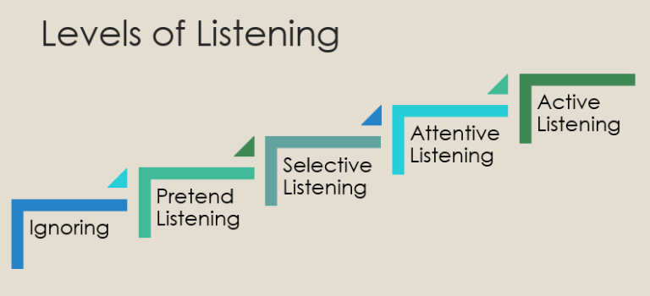
LEVELS of EFFECTIVE Listening

Slide 14
Level 1: Ignoring
The lowest level of listening: No effort is being given by the listener.
Distraction – Maybe the listener is busy. Try calling the individual by name to get their attention.
Intentional ignoring –Maybe you’ve fought with someone and they are simply not going to acknowledge you. Or the listener doesn’t want to acknowledge the information.
Physical restrictions – There could be a hearing problem. Or maybe the listener has earphones in.

Slide 15
Level 2: Pretend Listening
Where the listener is giving an appearance of listening, but not really engaged
If the information does not have value to the listener

Slide 16
Level 3 – Selective Listening
When we pay attention to people as long as we agree with them or if we are desirous to hear what they have to say
The listener will be quick to jump and interrupt the speaker to add something, change the topic or to simply finish the other person’s sentences.
The dangerous part of this level is that it is easy to fall into the ignoring or pretend listening levels.

Slide 17
Level 4 – Attentive Listening
Where we tend to spend most of our time as listeners
The listener listens and evaluates the information determining if they agree or disagree with the information or if it is valuable to them.
A word of caution: If a listener determines that the information is not as important, they may fall from the attentive listening level to a lower level of listening.

Slide 18
Level 5 -Active or Empathetic Listening
The pinnacle of listening
The listener gives their full attention – completely focused on the speaker. This is where the old adage comes to play – walking in another’s shoes. The listener gives their whole self to the conversation – ears, heart and mind.
This is the hardest level of listening to achieve because it does require so much energy from the listener.

